Slide 1
Spanning Tree Protocol
Cat2960 Software Guide – Configuring STP
http://www.cisco.com/c/en/us/td/docs/switches/lan/catalyst2960/software/release/12-2_53_se/configuration/guide/2960scg/swstp.html
Understanding RSTP (802.1w)
http://www.cisco.com/c/en/us/support/docs/lan-switching/spanning-tree-protocol/24062-146.html

Slide 2
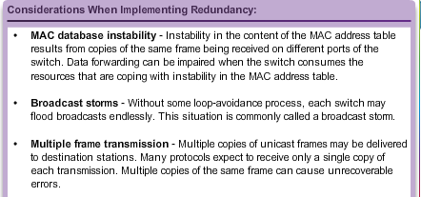
Purpose of Spanning Tree Redundancy at OSI Layers 1 and 2
Multiple cabled paths between switches:
Provide physical redundancy in a switched network.
Improves the reliability and availability of the network.
Enables users to access network resources, despite path disruption.
Notes:
2.1.1.1 Redundancy of OSI Layers 1 and 2

Slide 3
Purpose of Spanning Tree Issues with Layer 1 Redundancy: MAC Database Instability
Ethernet frames do not have a time to live (TTL) attribute.
Frames continue to propagate between switches endlessly, or until a link is disrupted and breaks the loop.
Results in MAC database instability.
Can occur due to broadcast frames forwarding.
If there is more than one path for the frame to be forwarded out, an endless loop can result.
When a loop occurs, it is possible for the MAC address table on a switch to constantly change with the updates from the broadcast frames, resulting in MAC database instability.
Notes:
2.1.1.2 Issues with Layer 1 Redundancy: MAC Database Instability

Slide 4
Purpose of Spanning Tree Issues with Layer 1 Redundancy: Broadcast Storms
A broadcast storm occurs when there are so many broadcast frames caught in a Layer 2 loop that all available bandwidth is consumed. It is also known as denial of service
A broadcast storm is inevitable on a looped network.
As more devices send broadcasts over the network, more traffic is caught within the loop; thus consuming more resources.
This eventually creates a broadcast storm that causes the network to fail.
Notes:
2.1.1.3 Issues with Layer 1 Redundancy: Broadcast Storms

Slide 5
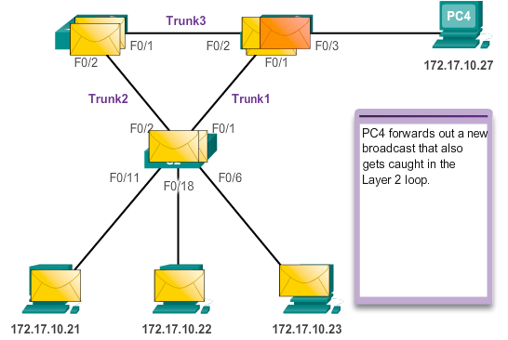
Purpose of Spanning Tree Issues with Layer 1 Redundancy: Broadcast Storms
Notes:
2.1.1.3 Issues with Layer 1 Redundancy: Broadcast Storms (cont.)

Slide 6
Purpose of Spanning Tree Issues with Layer 1 Redundancy: Duplicate Unicast Frames
Unicast frames sent onto a looped network can result in duplicate frames arriving at the destination device.
Most upper layer protocols are not designed to recognize, or cope with, duplicate transmissions.
Layer 2 LAN protocols, such as Ethernet, lack a mechanism to recognize and eliminate endlessly looping frames.
Notes:
2.1.1.4 Issues with Layer 1 Redundancy: Duplicate Unicast Frames

Slide 7
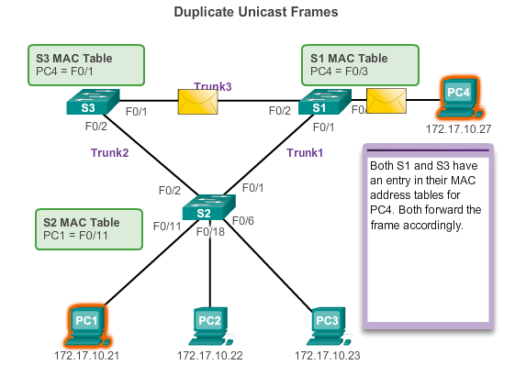
Purpose of Spanning Tree Issues with Layer 1 Redundancy: Duplicate Unicast Frames
Notes:
2.1.1.4 Issues with Layer 1 Redundancy: Duplicate Unicast Frames (cont.)
Switch flood frames if no MAC address table entry

Slide 8
STP Operation Spanning Tree Algorithm: Introduction
STP ensures that there is only one logical path between all destinations on the network by intentionally blocking redundant paths that could cause a loop.
A port is considered blocked when user data is prevented from entering or leaving that port. This does not include bridge protocol data unit (BPDU) frames that are used by STP to prevent loops.
The physical paths still exist to provide redundancy, but these paths are disabled to prevent the loops from occurring.
If the path is ever needed to compensate for a network cable or switch failure, STP recalculates the paths and unblocks the necessary ports to allow the redundant path to become active.
Notes:
2.1.2.1 Spanning Tree Algorithm Introduction

Slide 9
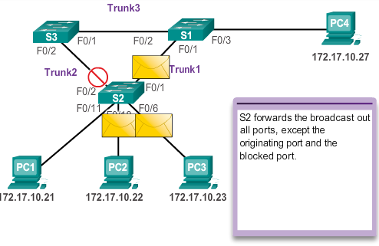
STP Operation Spanning Tree Algorithm: Introduction
Notes:
2.1.2.1 Spanning Tree Algorithm Introduction (cont.)

Slide 10
Spanning Tree Operation
1. STP elects a root bridge
2. All working root bridge interfaces are set to forwarding state
3. Each non root switch determines a port to have the least administrative cost (root cost) between itself and the root switch.
4. This port is called the root port and is set to forwarding
Notes:
Draw a 3 switch network on the whiteboard

Slide 11
Spanning Tree Operation
5. The switch with the lowest root cost, compared with other switches attached to the same link is set to forwarding state. This port is the designated port.
6. All other interfaces are placed in blocking state

Slide 12
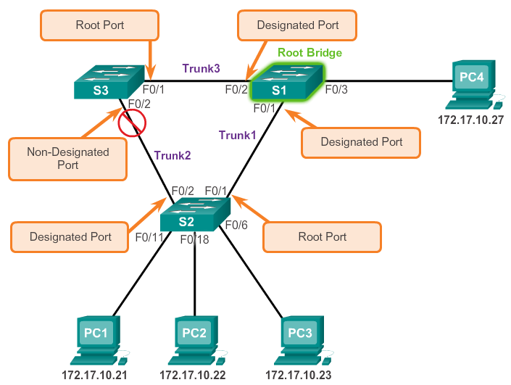
STP Operation Spanning Tree Algorithm: Port Roles
Notes:
2.1.2.2 Spanning Tree Algorithm: Port Roles

Slide 13
BPDU
STP messages are called Bridge Port Data Units (BPDU)
Hello BPDU defines
Root Bride ID
Sender’s bridge ID
Sender’s path cost (to root)
Timers (Hello, MaxAge, forward delay)

Slide 14
Root Bridge Election
Lowest Bridge ID (BID) is elected root
BID has 2 parts
Priority & MAC address
Lowest priority will become root. MAC address is essentially a tie breaker
Notes:
Why are the implications of using lowest MAC address?

Slide 15
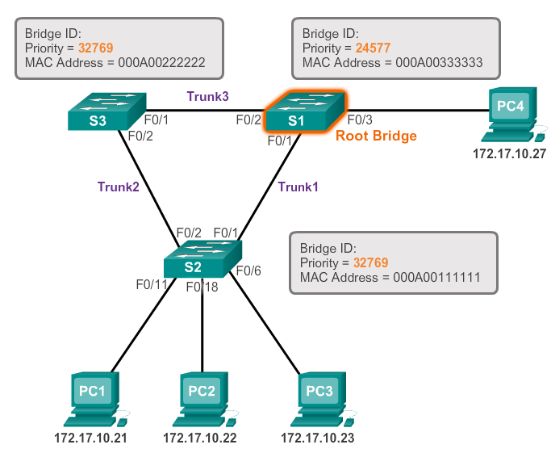
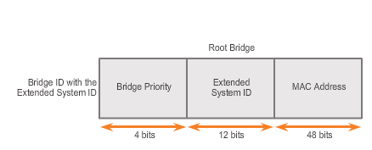
STP Operation Spanning Tree Algorithm: Root Bridge
Notes:
2.1.2.3 Spanning Tree Algorithm: Root Bridge
ESI = VLAN

Slide 16
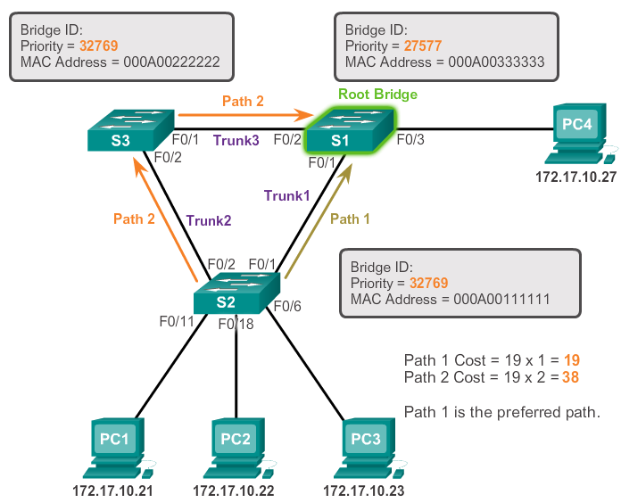
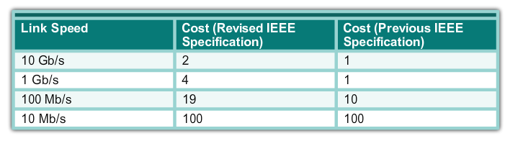
STP Operation Spanning Tree Algorithm: Path Cost
Notes:
2.1.2.4 Spanning Tree Algorithm: Path Cost
Each non Root switch chooses 1 (only) root port = least STP path cost to the root.
Designated Port elected per segment (S2 – S3). Switch with lowest accumulated path cost is designated port. Tie breaker = lowest BID, then lowest sender port ID (interface ID)
Q Why would there be a tie in BID? (A multiple links between same 2 switches).

Slide 17
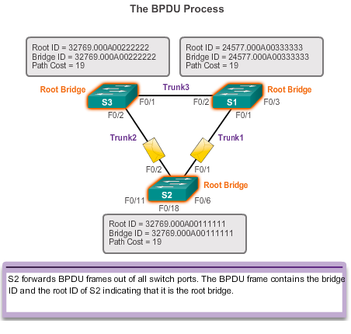
STP Operation BPDU Propagation and Process
Notes:
2.1.2.6 BPDU Propagation and Process
Each switch when it comes online sends out BPDUs advertising itself as the root.
As each switch receives BPDUs it compares the BID with its own.

Slide 18
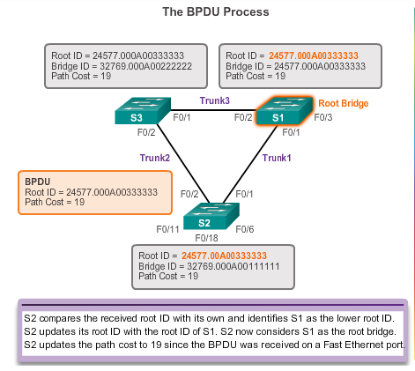
STP Operation BPDU Propagation and Process
Notes:
2.1.2.6 BPDU Propagation and Process

Slide 19
Overview List of Spanning Tree Protocols
STP or IEEE 802.1D-1998
PVST+
IEEE 802.1D-2004
Rapid Spanning Tree Protocol (RSTP) or IEEE 802.1w
Rapid PVST+
Multiple Spanning Tree Protocol (MSTP) or IEEE 802.1s
Notes:
2.2.1.1 List of Spanning Tree Protocols
We focus on PVST+ & Rapid PVST+

Slide 20
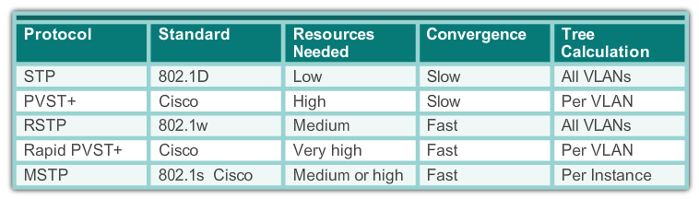
STP Overview Characteristics of the Spanning Tree Protocols
Notes:
2.2.1.2 Characteristics of the Spanning Tree Protocols

Slide 21
PVST+ Overview of PVST+
Networks running PVST+ have these characteristics:
A network can run an independent IEEE 802.1D STP instance for each VLAN in the network.
Optimum load balancing can result.
One spanning-tree instance for each VLAN maintained can mean a considerable waste of CPU cycles for all the switches in the network. In addition to the bandwidth that is used for each instance to send its own BPDU.
Notes:
2.2.2.1Overview of PVST+

Slide 22
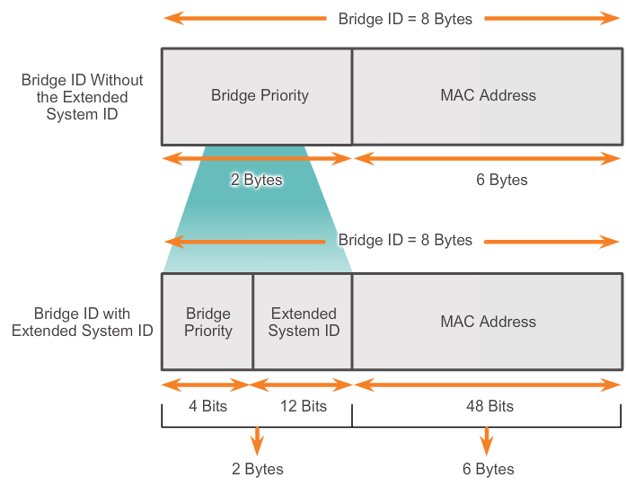
STP Operation Extended System ID
STP was enhanced to include support for VLANs, requiring the VLAN ID to be included in the BPDU frame through the use of the extended system ID
Notes:
2.1.2.7 Extended System ID

Slide 23
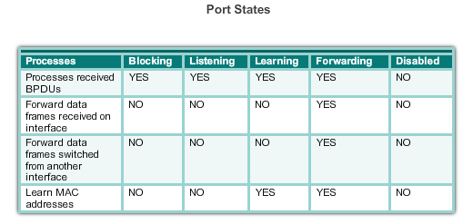
PVST+ Port States and PVST+ Operation
STP introduces the five port states:
Notes:
2.2.2.2 Port States and PVST+ Operation
Listen = listen for BPDUs
Learn – learn MAC addresses
Forward – pass traffic

Slide 24
STP Timers
Variable |  | Description
forward-time | 15 sec | Controls how fast a port changes its spanning tree state from blocking to forwarding. Port stays in each of listening then learning state for this time.
hello-time | 2 sec | How often the switch broadcasts its hello message to other switches
max-age | 10 sec | Controls the maximum time for the STP information to be retained before it is discarded (Hello x Max-age).
Notes:
Issue – end user port can take to long to transition to forwarding = DHCP fails, can’t login etc

Slide 25
PVST+ Convergence
Only the root sends BPDUs
Non-root bridges only forward on BPDUs that are received from the root-bridge via their root port
If a switch detects a failure it sends a topology change notification (TCN) to the root bridge. Then the root bridge sends the TCN out to all remaining bridges in the switching domain
The TCN tells a switch to reduce the timeout age for its MAC address-table to help speed up the recovery process

Slide 26
PVST+ Convergence
Direct link failure can take 30 sec to recover (Transition through Listening & Learning states)
Indirect failure convergence time can be 50 sec = above 30 sec + 20 sec for old BPDU to age out (hello x max age timer)

Slide 27
Rapid PVST+ Overview of Rapid PVST+
RSTP is the preferred protocol for preventing Layer 2 loops in a switched network environment.
With Rapid PVST+, an independent instance of RSTP runs for each VLAN.
RSTP supports a new port type: an alternate port in discarding state.
There are no blocking ports. RSTP defines port states as discarding, learning, or forwarding.
RSTP (802.1w) supersedes STP (802.1D) while retaining backward compatibility
RSTP keeps the same BPDU format as IEEE 802.1D, except that the version field is set to 2 to indicate RSTP, and the flags field uses all 8 bits.
Notes:
2.2.3.1 Overview of Rapid PVST+
Can transition between port states much faster

Slide 28
802.1D vs 802.1w
STP (802.1D) Port State | RSTP (802.1w) Port State | Is Port Included in Active Topology? | Is Port Learning MAC Addresses?
Disabled | Discarding | No | No
Blocking | Discarding | No | No
Listening | Discarding | Yes | No
Learning | Learning | Yes | Yes
Forwarding | Forwarding | Yes | Yes

Slide 29
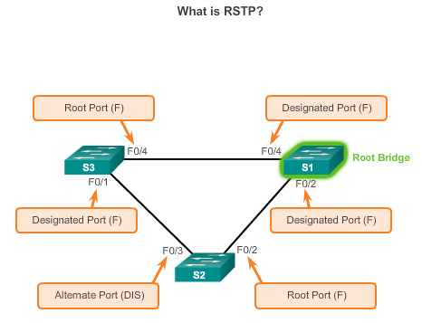
Rapid PVST+ Overview of Rapid PVST+
Notes:
2.2.3.1 Overview of Rapid PVST+
Blocking port = now Alternate port
The Alternate DIS port can transition to forwarding immediately

Slide 30
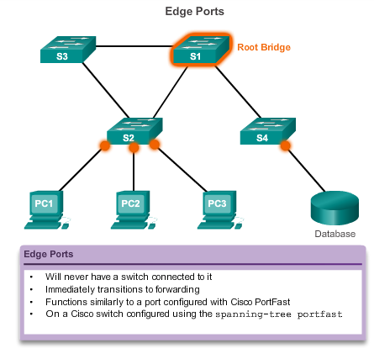
Rapid PVST+ Edge Ports
Notes:
2.2.3.3 Edge Ports

Slide 31
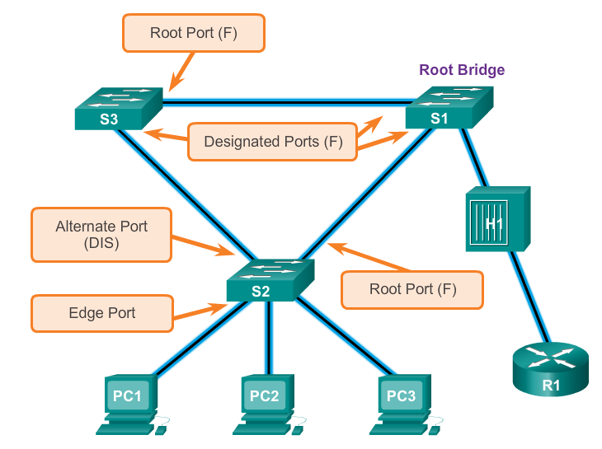
Rapid PVST+ Link Types
The link type can determine whether the port can immediately transition to forwarding state. Edge port connections and point-to-point connections are candidates for rapid transition to forwarding state.
Notes:
2.2.3.4 Link Types
The Alternate DIS port can transition to forwarding immediately

Slide 32
RSTP Convergence
All bridges generate BPDU every Hello (2 sec) used as keepalive mechanism
Any switch that detects a failure can advise the switching domain of the TCN(Topology Change Notification) immediately
Direct detection (local physical link failure) can take milliseconds
Indirect detection = 3 x hello timer (if physical link still up) = 6 sec (default)

Slide 33
Spanning Tree Configuration

Slide 34
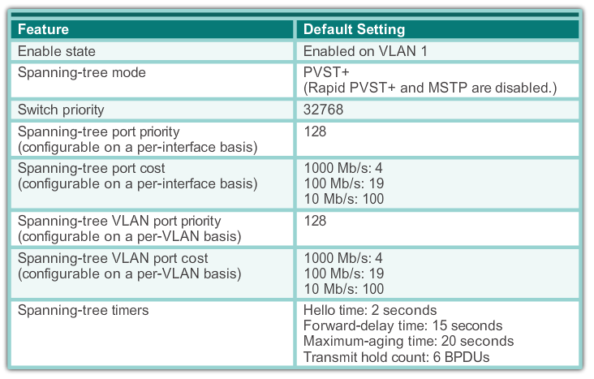
PVST+ Configuration Catalyst 2960 Default Configuration
Notes:
2.3.1.1 Catalyst 2960 Default Configuration

Slide 35
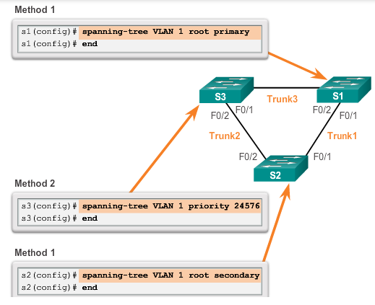
PVST+ Configuration Configuring and Verifying the Bridge ID
Notes:
2.3.1.2 Configuring and Verifying the Bridge ID
Default = 32768
Primary = set priority to 24576 or 4096 if needed to become root
Secondary = set priority 28672

Slide 36
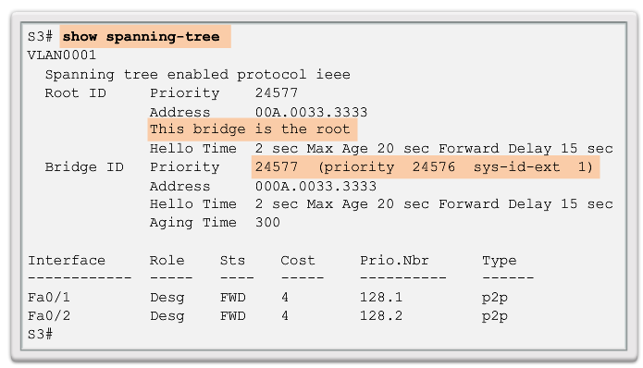
PVST+ Configuration Configuring and Verifying the Bridge ID
Notes:
2.3.1.2 Configuring and Verifying the Bridge ID

Slide 37
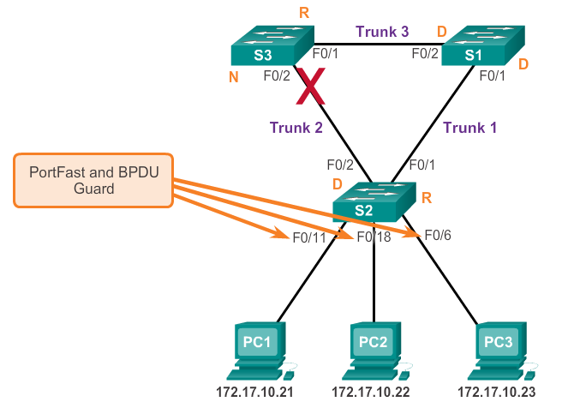
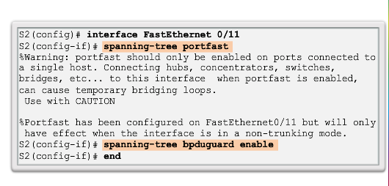
PVST+ Configuration PortFast and BPDU Guard
When a switch port is configured with PortFast that port transitions from blocking to forwarding state immediately.
BPDU guard puts the port in an error-disabled state on receipt of a BPDU.
Notes:
2.3.1.3 PortFast and BPDU Guard
The configuration of the features such as PortFast, BPDUguard, BPDUfilter, root guard, and loopguard are applicable in rapid−PVST+ mode also. The usage of these features are the same as in PVST+ mode. If you have already enabled these features in the PVST+ mode, the features remain active after the migration to rapid−PVST+ mode.
portfast = creates an RSTP edge port

Slide 38
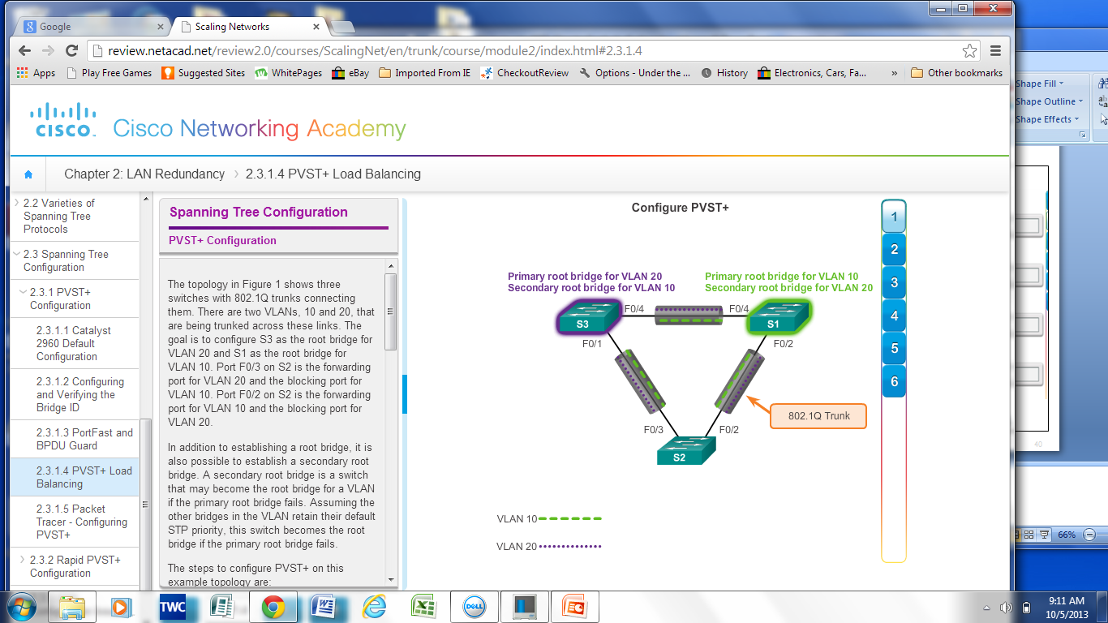
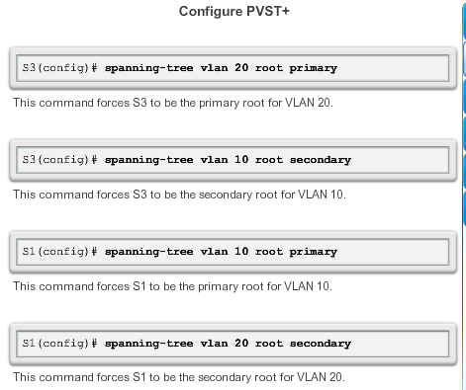
PVST+ Configuration PVST+ Load Balancing
Notes:
2.3.1.4 PVST+ Load Balancing

Slide 39
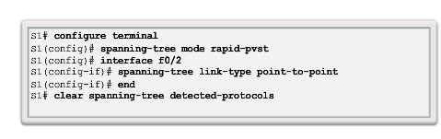
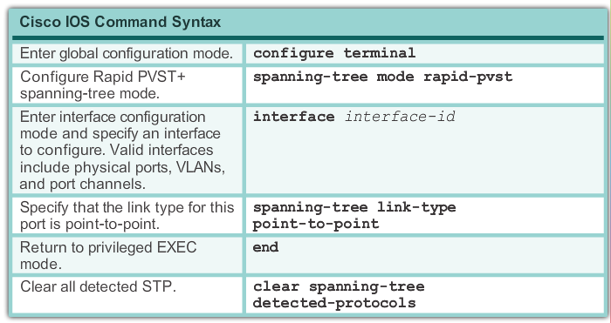
Rapid PVST+ Configuration Spanning Tree Mode
Rapid PVST+ is the Cisco implementation of RSTP. It supports RSTP on a per-VLAN basis.
Notes:
2.3.2.1 Spanning Tree Mode
Default = PVST+
The configuration of the features such as PortFast, BPDUguard, BPDUfilter, root guard, and loopguard are applicable in rapid−PVST+ mode also. The usage of these features are the same as in PVST+ mode. If you have already enabled these features in the PVST+ mode, the features remain active after the migration to rapid−PVST+ mode.

